Slide 1
WireShark & Wireless Security Homework

Slide 2






Finish WireShark Demonstration
ICMP Fingerprinting
Notes:
Payload
TTL
Sequence #

Slide 3
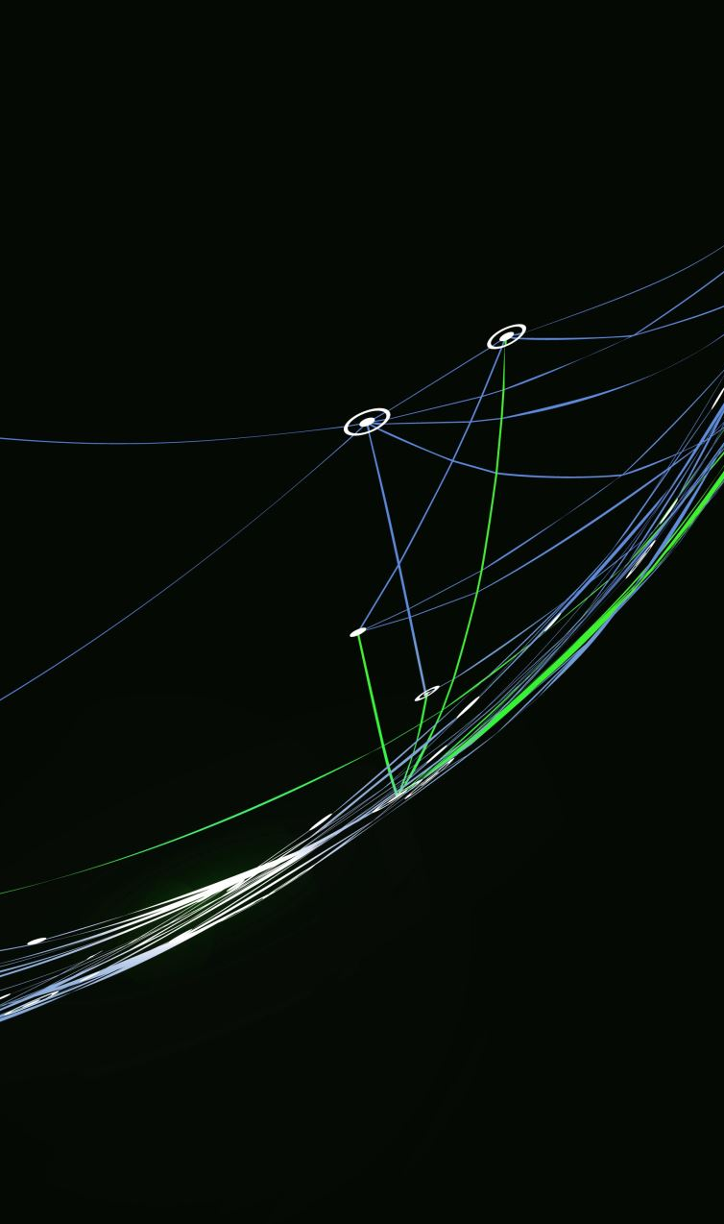
Finish WireShark Demonstration
TCP 3-Way Handshake Fingerprinting
Notes:
Just look at flags
Talk about spoofing TCP v. UDP w/ “Scapy.py”

Slide 4
Finish WireShark Demonstration
FILTERS (Google)
Notes:
Google image search
Find google traffic
Note that it is encrypted

Slide 5

Finish WireShark Demonstration
FILTERS (SELECTING RELEVANT PACKETS)
Notes:
Ping www.google.com
Ping www.yahoo.com
Filter on www.google.com IP.addr (get both sides of the conversation)
Export selected packets (FILE | Export Specified Packets)

Slide 6

Finish WireShark Demonstration
FILTERS (file carving)
Notes:
1. File | Export Objects | HTTP

Slide 7
Homework Assignment #1
Spoof your MAC address to be: 88:66:5a:43:61:74
Capture local network traffic using any method you like:
tcpdump
tshark
WireShark
Browse to https://www.google.com and perform an image search for “Cat”.
Save one of the images to your computer.
Stop capturing local network traffic.
Carve the image of the cat you saved from the network capture.
Submit a ZIP file on Canvas containing:
A packet capture file containing only the network packets related to the Google image search.
The cat image you saved.
Any relevant encryption keys or certificates.
Due 2/23 @ 11:59 PM
Reminder: NO LATE WORK ACCEPTED FOR ANY REASON!

Slide 8
Homework Assignment #2 Selected practice problems
I will select and post several review questions and problems from the end of the assigned reading chapters (Beard).
You MUST use LaTeX when writing your answers!
Submit a single ZIP file to Canvas, containing:
Single PDF containing your answers organized by Section and subsection.
Any LaTeX files needed to compile your PDF, including templates, tex files, image files, etc.
Due 2/29@ 11:59 PM
Notes:
Demonstrate TexLive
s(t) = A \times \frac{4}{\pi} \times \sum_{k\textrm{ odd, }k=1}^{\infty} \frac{sin (2 \pi kft)}{k}
(From pg. 15 of Beard)

Slide 9

Wireless Security Considerations
Notes:
Play 2.mp3 (What is it?)
Demo live oscilloscope web page! (https://academo.org/demos/virtual-oscilloscope/)
3. Describe Ft. Polk wireless security problems from perspective of Byzantine Generals problem.

